Slide 1
Day 2 – Introduction to Zephyr

Slide 2
Table of Contents – Day 1
About Zephyr
Features of Zephyr for JIRA
Adding Zephyr Plugin to Jira Cloud
How to use the Zephyr for JIRA test management tool
  Create a Test
  Modify and View a Test
  Create a Test Cycle
  Add Tests to Test Cycles
  Assign Test Executions
  Execute the Tests
  View Testing Progress

Slide 3
About Zephyr
Zephyr for JIRA is a native application that exists in JIRA and brings quality test management capabilities to any JIRA project.
When Zephyr is used with JIRA, the test can be created, viewed in any JIRA project, and executed immediately or as part of a testing cycle that may be linked to other issues.
The detailed testing metrics can be tracked via customizable Zephyr gadgets.
Zephyr provides multiple deployment options:
Zephyr for JIRA Cloud
Zephyr for JIRA Server
Zephyr for JIRA Data Center

Slide 4
Features of Zephyr for JIRA
Native to JIRA allowing users to test right inside JIRA
  Testing is integrated into the project cycles and it enables you to track software quality and make empowered go/no-go decisions.
Create, Plan, and Execute Tests
  Create, view, and modify test steps and attachments for individual tests. Build test execution cycles, execute the tests, and link defects to specific tests.
Track Quality Metrics
  Zephyr provides easy-to-use dashboard which provides testing metrics on the testing activities throughout every project.

Slide 5
Adding Zephyr Plugin to Jira Cloud
We need to add the Zephyr plugin to the Jira Board
Go to Settings -> Apps –> Search for Zephyr in Marketplace -> Add Free Trial
Ensure that “Test” has been added as a Issues Type in Jira
  Settings -> Issues -> Issue Type Scheme- >Click Edit -> Add Test to your project

Slide 6
Create a Test
To create a test case (issue with type 'test'), simply click on the 'Create' button located in the top menu navigation.
The 'Create Issue' module will appear with the following fields when creating a test case. The required fields for a test case are the following:
  Project – The name of the project that the test case is being placed after creation.
  Issue Type – The issue type for the test case (in this case, we'll select 'Test').
  Summary – The name/title for the test case.
  Reporter – The name of the individual creating the test case.
Once the required fields are filled out, users can scroll to the bottom of the interface and create test steps for the test case which includes the following information for each test step:
  Test Step – Description of the test step/action that needs to be performed for this individual step.
  Test Data – Any data that is required for the test step to be performed.
  Expected Result – The expected result after performing the actions for this individual step.

Slide 7
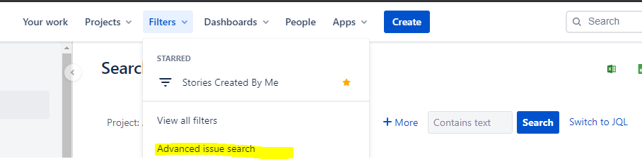
Modify And View a Test Case
We can edit and modify the already written test cases
Search for Test Cases – Go to Filters . And click as below
Select Issue Type as “Test” . You will see all the test Cases.
Click on any , and you will be able to edit the same.

Slide 8
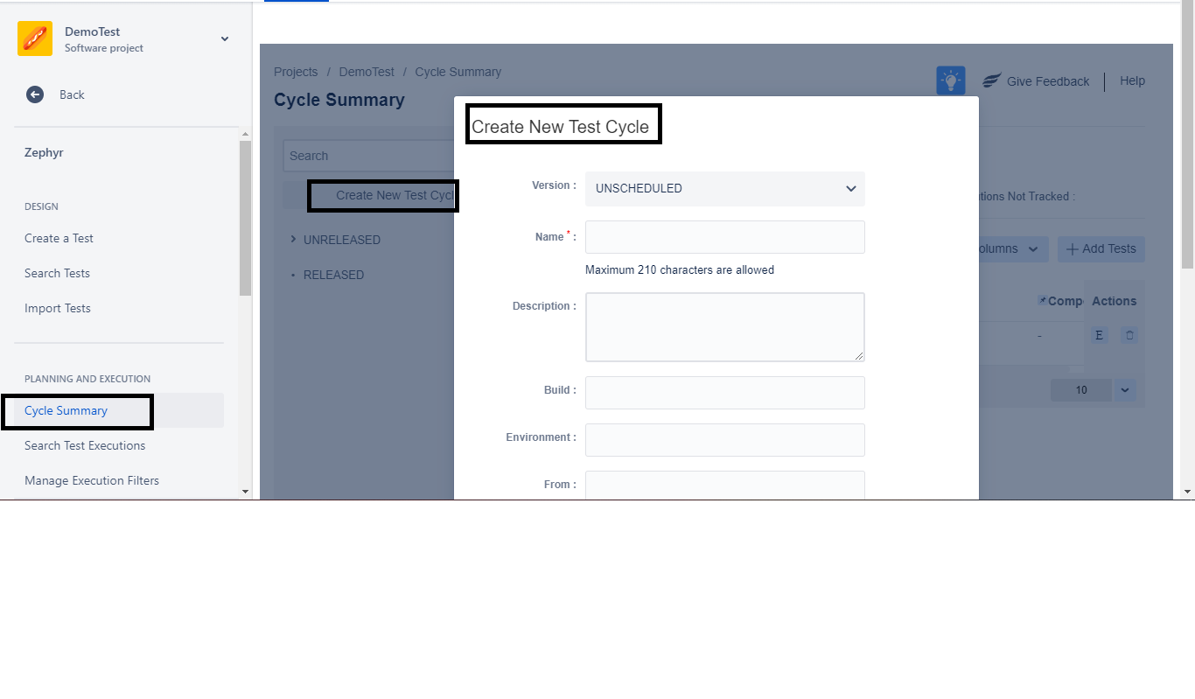
Create a Test Cycle
Test Cycles are used to set up and execute tests in a structured manner. This allows tests to be grouped logically and executed in a structured fashion. It also allows for the tracking of progress and reporting of quality metrics.
To create a test cycle, click on the 'Cycle Summary' tab
Version – Shows the list of versions that exist for this project.
Name – Name of the test cycle (this is a required field).
Description – A description given for the test cycle.
Build – This is an informational field only for further detail on the build (if any).
Environment – This is an information field only for further detail on the environment (if any).
From – The start date of the testing cycle.
To – The end date of the testing cycle. The end date is not necessarily enforced (users can continue adding tests to the test cycle and executing them beyond this date).

Slide 9
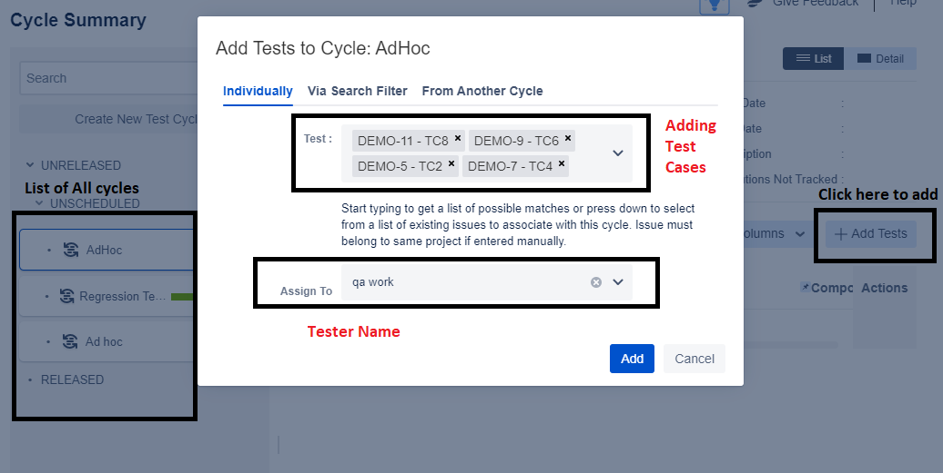
Adding Test to Test Cycle
It means to assign the Test cases that you would like to execute for a particular cycle eg(Regression , adhoc, negative)

Slide 10
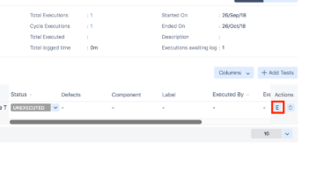
Assigning Test Execution
On the 'Cycle Summary' page, click on the 'E' button for the individual test case that you want to assign.
This displays the test execution for that specific test and you can assign the test execution to a different user if need be. This can be done by using the 'Assigned To' drop-down list and selecting a different user.After selecting a different user, it will autosave the test execution.

Slide 11
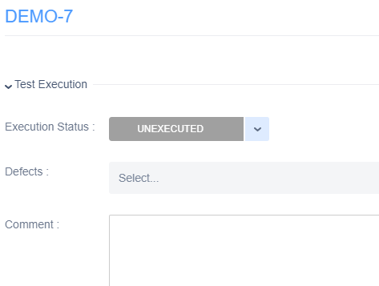
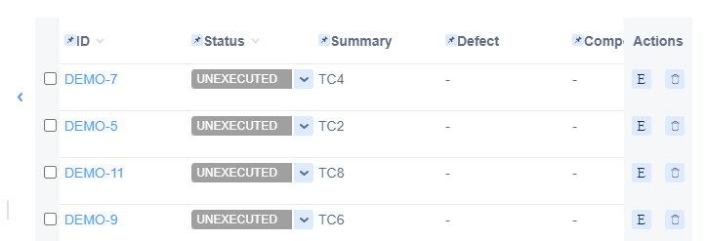
Executing Test Case
Users can quick execute test cases by using the drop-down list in the 'Status' column of the test execution table within the testing cycle. Users can also execute their test cases in further detail by clicking on the 'E' button for the individual test that needs to be executed.
After clicking on the 'E' button, users can execute the entire test case by simply changing and updating the execution status of the test case. This can be done by using the 'Execution Status' drop-down list and selecting one the statuses listed. This will execute the test case.
Users are also able to execute not only the entire test case but the individual test steps as well. Simply scroll down until you see the Test Details sections and then click on the drop-down list in the 'Status' column for the individual test step.Select and update the status of the test step and this will execute the individual test step.

Slide 12
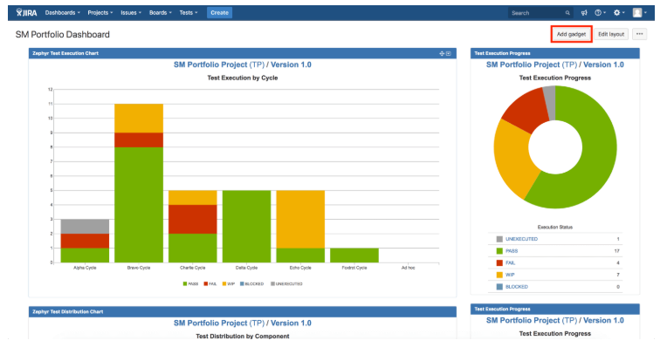
View Progress
To view your test progress of all your testing activities, simply click on 'Dashboards' at the left of the top menu navigation. Then click on the existing dashboard to open up the dashboard.

